Slide 1
Sorting Algorithms
By Rydia Titus

Slide 2
The basics
I made four algorithms instead of three because one refused to work, so I made another one, but then was stubborn so I just fixed the old one and kept both in.

Slide 3
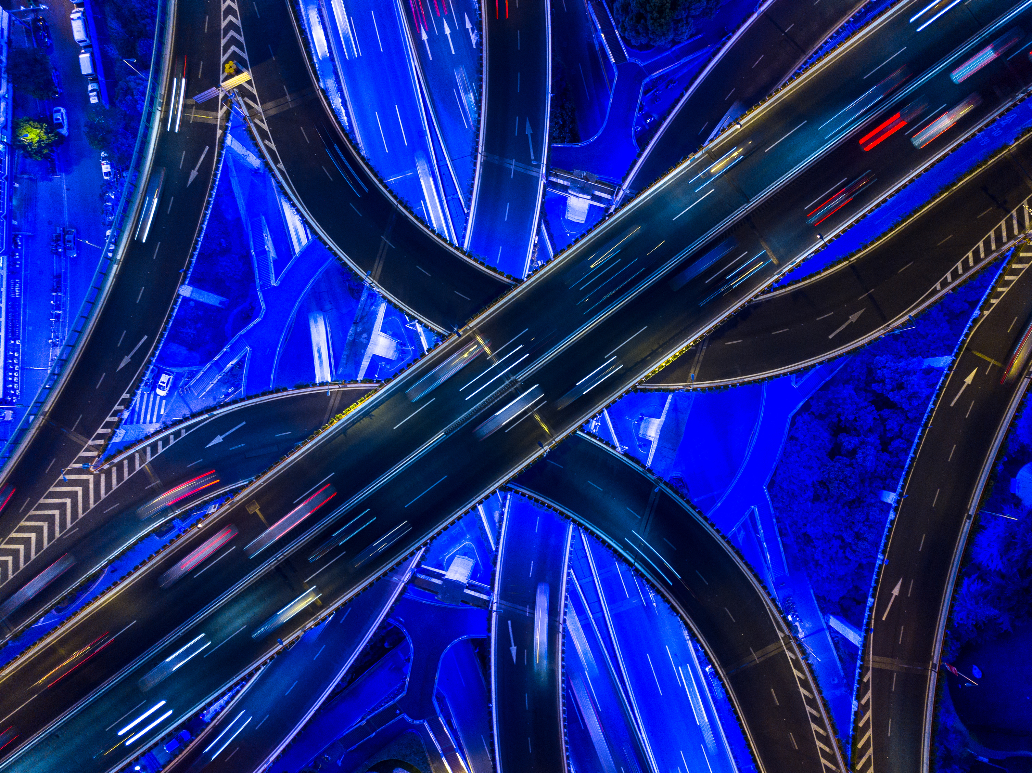
The Challengers:
Bubble Sort
A classic sort, easy to understand and implement. Will it prove that simpler is better?
Insertion Sort
Simple, yet effective. Got an item? Find where it needs to go and put it there. More complicated than Bubble, but it’s efficiency might give it the edge it needs!
Quick Sort
Partitions, pivots, and buckets, oh my! Simplicity is definitely not key with this beauty. In the name of efficiency, it uses recursion to partition ever smaller sections and glue them together. Will it pay off in the end?
Tim Sort
I mostly did this one because the name was funny compared to the others. As a combination of multiple other sorts, using ideas from all over the place, it serves as the best of many worlds. It believes itself to be one of the best. Will it live up to its expectation?

Slide 4

I should probably explain
See, I’m really bored at this point. I had a lot more fun putting together the visualizer. So I’m just going to have fun with this part.

Slide 5
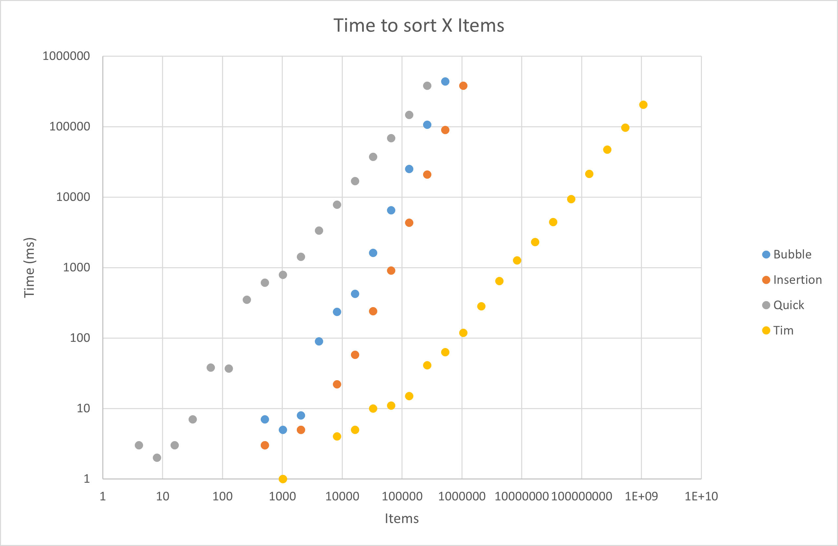
Time to Run
Here’s our challengers racing to sort their given amounts of items! They were taken out of the race as soon as their sort took longer than 5 minutes, or in this case, 300,000 milliseconds. Only one challenger made it all the way to 2^30 items, the maximum allowed.
For that reason, the winner of the Time Bracket is…
Tim Sort!111!!1!!111!
As for the others, we can see that Quick was the slowest, followed by Bubble and Insertion. There seemed to be a few hiccups here and there, owing mostly to the random nature of the arrays they were given.
(the yellow one)

Slide 6
Current Standings:
Tim Sort
Insertion Sort
Bubble Sort
Quick Sort

Slide 7
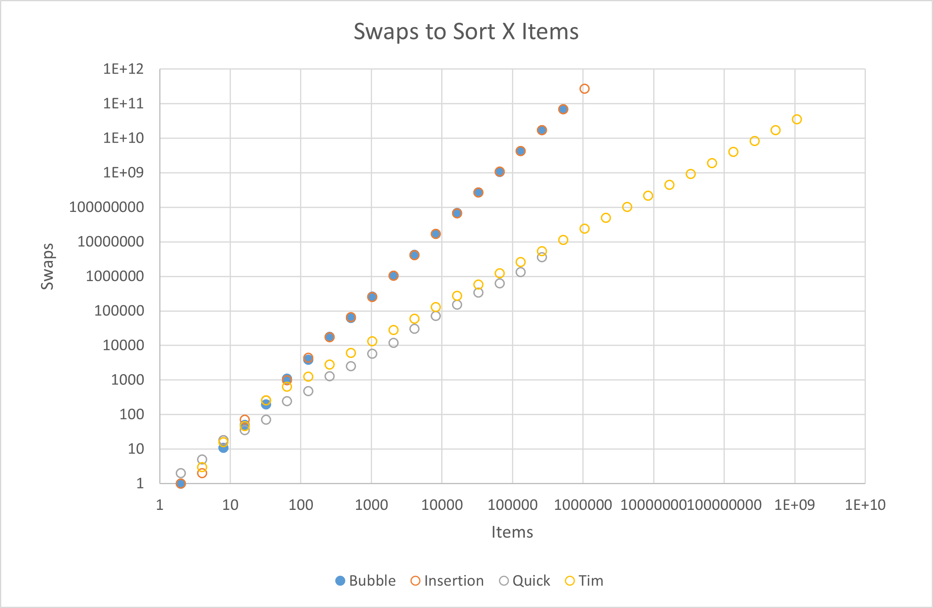
Number Of Swaps
In order to properly sort something, you need to swap its items around, and swapping takes memory, a precious resource. As such, like time, we’re playing by golf rules. The lower the better!
As such, the winner for the Swaps Bracket is…
Quick Sort!!!11!!111!
(the grey one)
As for the others, Bubble and Insertion are tied for dead last, while Tim makes a noticeable effort to stay on top, however in vain.

Slide 8

Current Standings:
Hello, nice lady.
Tim Sort
Quick Sort
Insertion Sort
Bubble Sort

Slide 9
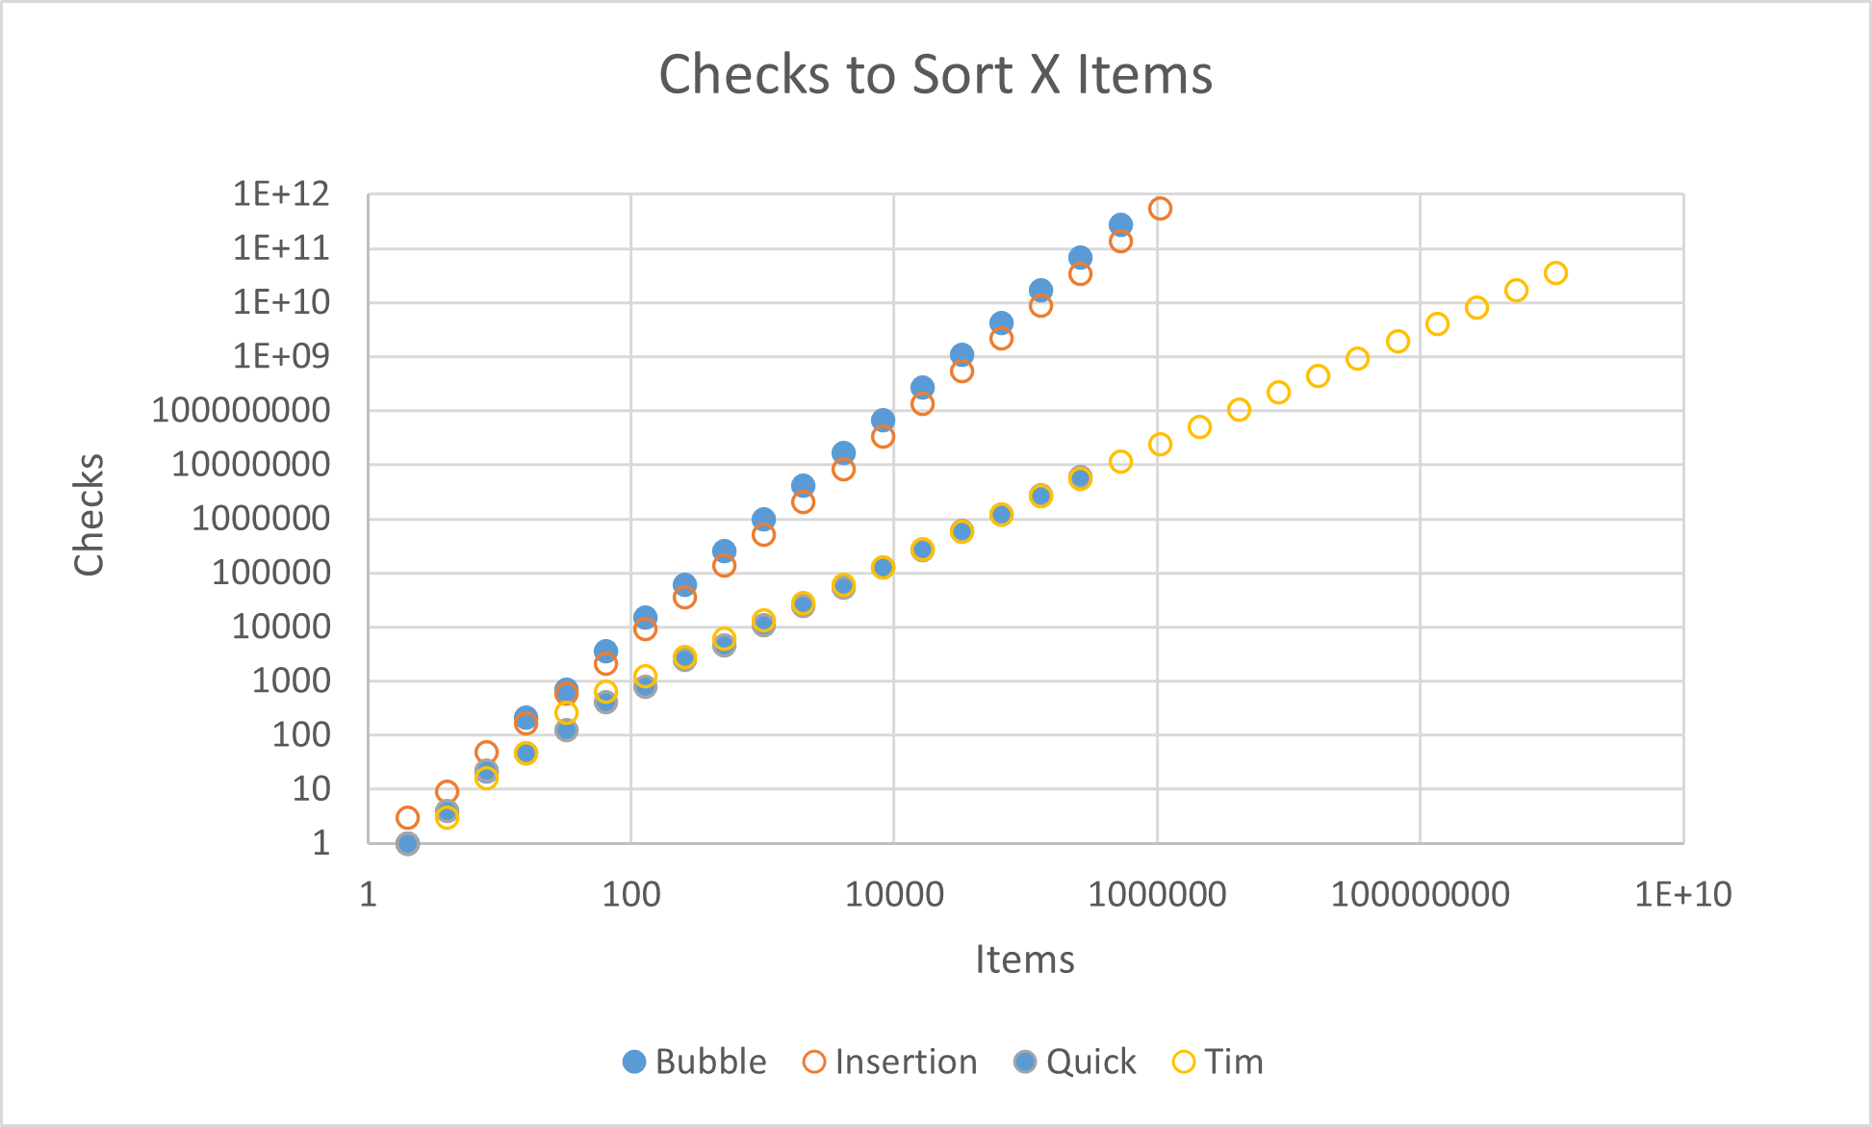
Number of Checks
Probably the hardest one to confirm, it follows pretty much the exact same principal as swaps: Checking takes memory and time, so the lower the better.
For that reason, the winner of the Checks Bracket is…
Tim Sort!!!11!!!!11!!
(the yellow one)
Bubble once again falls into last place, followed closely by Insertion. Tim and Quick are neck and neck, but by the current trends shown, Tim comes out on top.

Slide 10
The Current Standings:
Tim
Quick
Insertion
Bubble

Slide 11
Annoyance To Implement
Perhaps the most important category, Which algorithm gave me the smallest headache?
The winner of the Annoyance Bracket is…
Bubble Sort!!!1111111!!!11!
Algorithm | Implementation​ | Visualization​ | Final Grade​
Bubble | Practically just 10 lines of code. Probably the easiest sort ever to put together, bar BOGO​. | Also simplistic, just plug in what I did for Insertion.​ | A+​
Insertion​ | More complicated than Bubble, but still very easy to contain into one nice and simple function. | The first one I visualized, worked a treat. Not much complaining here.​ | A​
Quick | The first one that required more than one function. Kind of hellish and complicated, but that’s mostly because I’m dumb. | Makes funny sounds when I turn on the sound module.​ | B-
Tim | THIS WAS HELL. I had to do it twice because the first one kept breaking in seemingly random places. | Kept crashing when both piles were sorted, searched for 3 hours for the issue, turned out to be a parameter I wasn’t even using. | F- I hated doing this one with a burning passion.

Slide 12
Final Results:
Quick
Tim
Bubble
Insertion

Slide 13
OK I might be a little biased
Tim is the objectively better sort out of the four, I’m just salty because it was such a pain to get working. Not by any fault of its own, it just kept insisting on being annoying, and not telling me where the actual problem was, instead telling me that it was “at line 13”, when it was way lower at the function it was calling.
Man, I hate it when that happens.

Slide 14
In conclusion, I’m going to go stare at the visualizer some more.
Pretty lines go weeeeeeeeeeeeeeeeeeeeeeeeeeeeeeeeeeeeeeeeeeeeeeeeeeeeeeeeeeeeeeeeeeeeeeeeeeeeeeeeeeeeeeeeeeeeeeeeeeeeeeeeeeeeeeeeeeeeeeee

